Slide 1
Solution to WS5

Slide 2
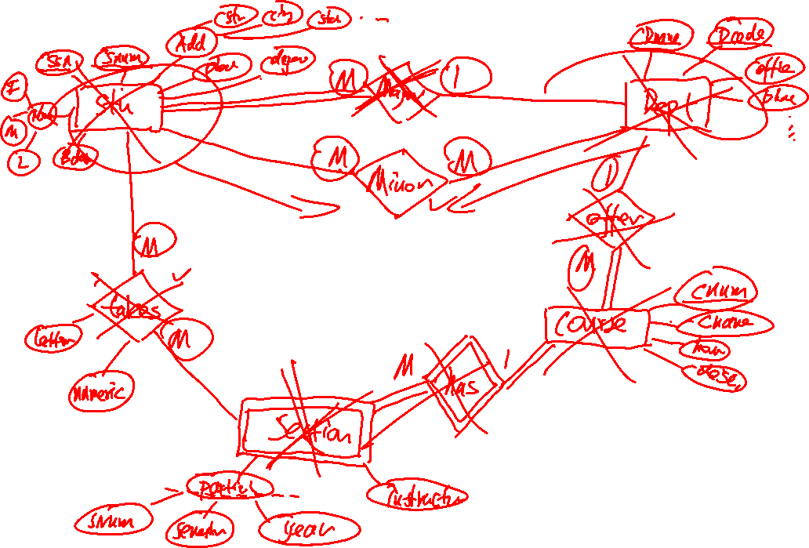

Slide 3
